Slide 1

Dynamics CRM Advanced Workflows

Slide 2

Mitch Milam
Dynamics CRM Architect
Independent consultant and trainer
Ten-Time Dynamics CRM MVP
mitch@xrmcoaches.com
infinite–x.net
@mitchmilam

Slide 3
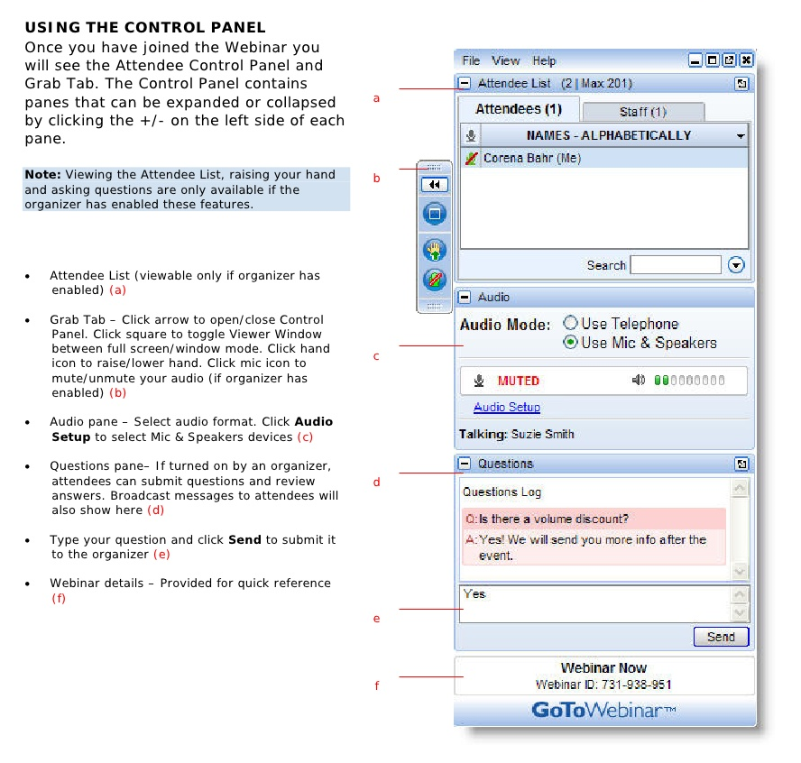
Webinar Housekeeping

Slide 4
Future Events
Webinar: Training Strategies to Increase Dynamics CRM User Adoption
Friday, Apr 29, 2016 10:00 AM – 11:00 AM CDT

Slide 5



2016 Training Roadmap
Webinars
http://www.xrmcoaches.com/webinars
KnowledgeBits
http://www.xrmcoaches.com/knowledgebits
Learning Plans
Availability –Coming soon
More Goodies
Practice tests
On–Demand video training
Instructor–led training
Books

Slide 6
Agenda
Process Automation
Workflow Design and Configuration
Troubleshooting and Management
Extending Workflows

Slide 7
Automating a Process

Slide 8
What are you Automating?
Lead to Customer
Opportunities
Other

Slide 9
First Things First
You must have a process to automate!

Slide 10
First Things First
You must have a clearly defined process to automate!

Slide 11
Mitch’s Rule #3
Technology does not solve process issues

Slide 12
Process Mapping
Document existing process steps
Get agreement from all parties
Determine technology requirements
Create the workflow(s)

Slide 13
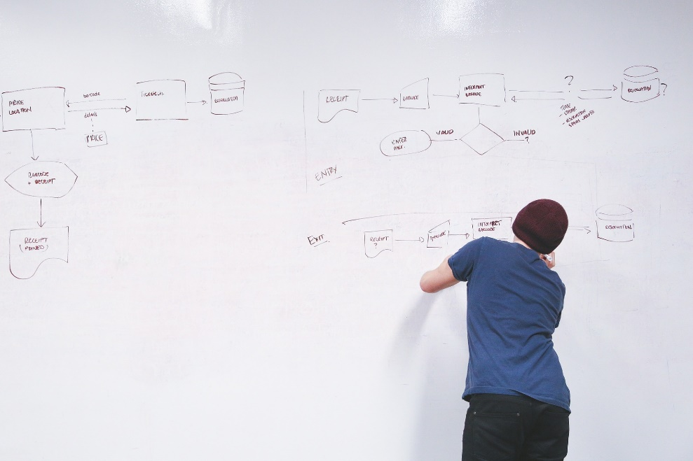


Getting Started

Slide 14
Workflow Design

Slide 15
Workflow Design
Simple is better than complicated

Slide 16
Workflow Design
If you can’t explain how it works to another person, then it is too complicated.

Slide 17
Workflow Design
Always keep maintenance in mind

Slide 18
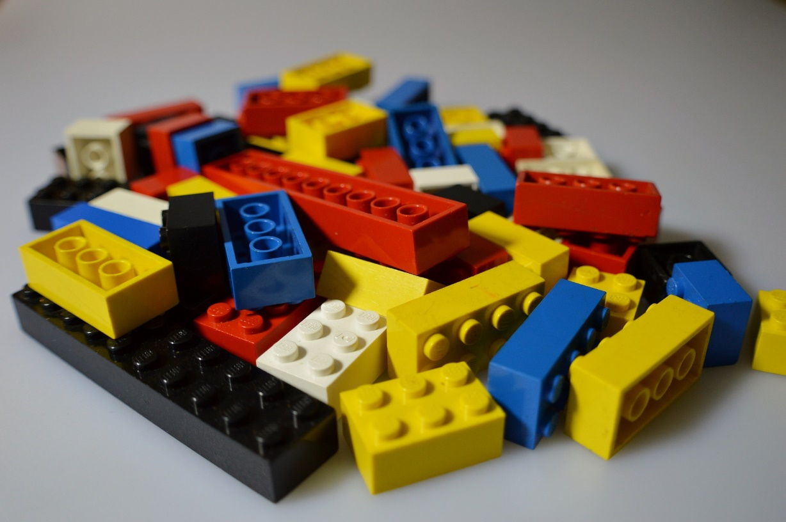
Workflow Design
Build Blocks

Slide 19

Workflow Design
Use Blocks to Make Structures

Slide 20
Workflow Design
Workflow
Step
Step
Step
Step
Step
Step
Master Workflow
Child Workflow
Step
Step
Child Workflow
Step
Step
Step
Child Workflow
Step
Child Workflow
Step
Step
Step

Slide 21
Workflow Design
Master
Child 1
Child 3
Child 4
Child 2

Slide 22
Workflow Configuration

Slide 23

Available to Run

Slide 24
Scope
User
Business Unit
Parent: Child Business Units
Organization

Slide 25
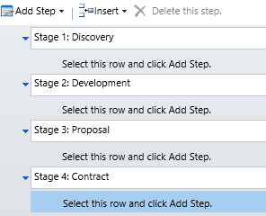
Step: Stage
Allows you to group a series of workflow steps
If a workflow has stages, then all steps must belong in a stage

Slide 26
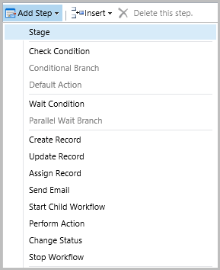
Steps

Slide 27
Workflow Design
Considerations

Slide 28
Naming Convention
Select a naming convention that makes sense to you
Parent vs. child workflows
Purpose (admin, marketing, sales)

Slide 29
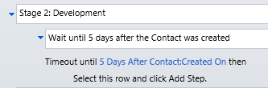
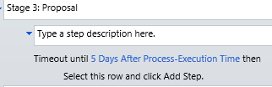
Wait vs. Timeout
Timeout
Waits for a specific amount of time or until a specific date

Slide 30
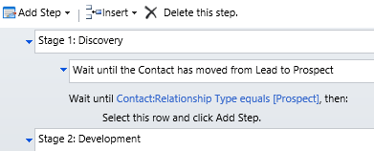
Wait vs. Timeout
Wait Condition
Waits until a specific action has occurred

Slide 31
Long-Running Workflows
How do we handle long-running workflows (months, years, etc.)?
Timeout
Batch process
Other

Slide 32
Remember
One a workflow starts, it cannot be changed

Slide 33
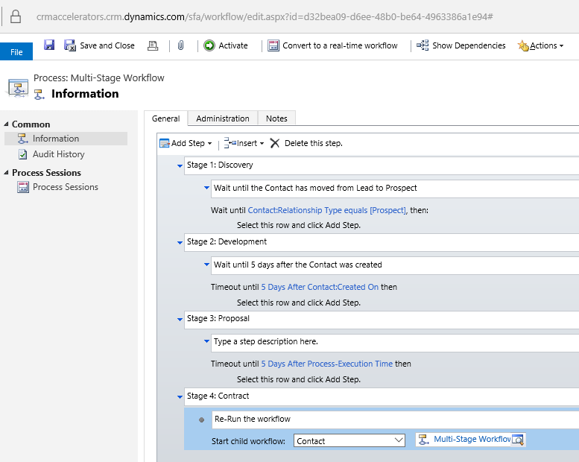
Restarting the Workflow

Slide 34
Extending Workflows

Slide 35
Additional Resources
CRM DateTime Workflow Utilities
Add Business Days
Add Days
Add Hours
Add Minutes
Add Months
Add Years
Date Difference Days
Date Difference Hours
Date Difference Minutes
Date Difference Months
Date Difference Years
Get Day Number Of Week
Get Day Number Of Year
Get Day Of Week
Get Quarter Number Of Year
Get Week Number Of Year
Get Month Start/End Dates
Get Quarter Start/End Dates
Get Week Start/End Dates
Get Year Start/End Dates
Is Between
Is Business Day
Is Same Day
Relative Time String
ToDateTime
To UTC String

Slide 36
Additional Resources
CRM Email Workflow Utilities
Email Business Unit
CC Business Unit
Email Security Role
CC Security Role
Email Team
CC Team
Delete Email Attachments
Delete Email Attachments By Name
Send Draft Email

Slide 37
Additional Resources
CRM String Workflow Utilities
Contains
Create Empty Spaces
EndsWith
Join
Length
PadLeft
PadLeft Dynamic
PadRight
PadRight Dynamic
Regex Match
Regex Replace
Replace
Reverse
StartsWith
Substring
ToLower
ToTitleCase
ToUpper
Trim
Word Count

Slide 38
Additional Resources
CRM Numeric Workflow Utilities
Add
Average
Divide
Max
Min
Multiply
Random Number
Round
Subtract
ToDecimal
ToInteger
Truncates

Slide 39
Additional Resources
MS Dynamics CRM 2011 Bulk Workflow Execution Tool
From ZeroToTen

Slide 40
Troubleshooting and Management

Slide 41
Workflow Failures
Two types of failures
Soft
Hard

Slide 42
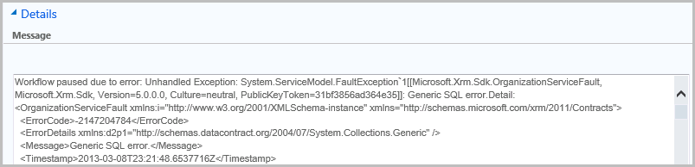
Error Example

Slide 43
Reviewing System Jobs
Build Personal Views
Monitor system jobs on a regular basis
Take action to correct issues
1
2
3

Slide 44
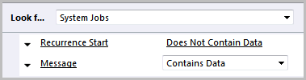
Personal View #1
System Jobs with Messages

Slide 45
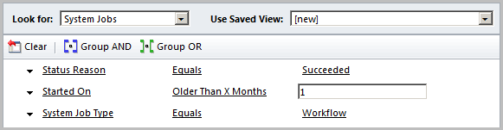
System Job Management: Bulk Delete
Remove successful workflows

Slide 46
Demonstration

Slide 47
Discussions

Slide 48
Questions?

Slide 49
Thank You

